Slide 1
Probability
EQ – What is probability without replacement?
Year 10 Mathematics

Slide 2
Lesson objective
By the end of this lesson you will be able to;
Constructs and uses tree diagrams to calculate probabilities
B grade and above: Constructs and uses tree diagrams to calculate probabilities in situations involving replacement and where there is no replacement
Notes:
Lesson

Slide 3
24
7
30
Topic: Probability
Date: 13/06/2018
EQ – What is probability without replacement?
In some experiments, the sample space, (list of possible outcomes) may change for the different events.
The probability for each event will be different.
Example:
There are 10 marbles in a bag. When you choose one and keep it there were 10 marbles in this first selection.
If you choose another marble and keep it, there are 9 marbles to choose from in the second selection.
What is probability without replacement?

Slide 4
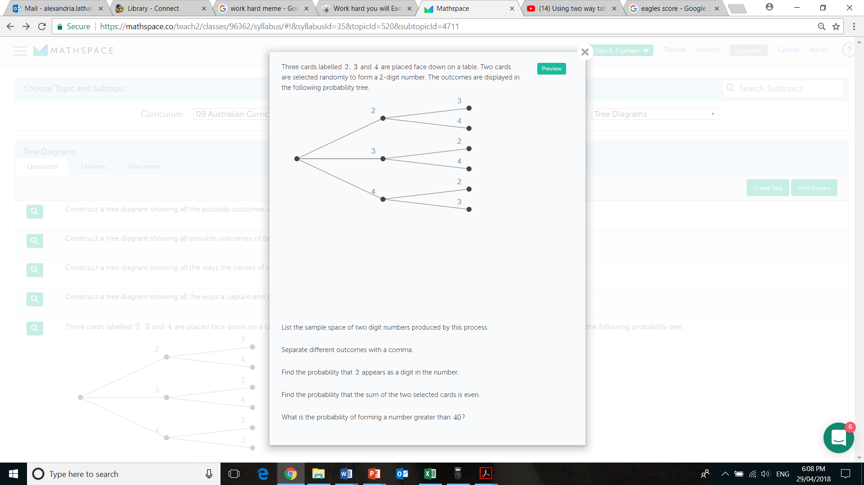
24
7
30
Topic: Probability
Date: 13/06/2018
EQ – What is probability without replacement?
Example
Since the cards are selected at the same time there is no replacement.

Slide 5







24
7
30
Topic: Two step Probability without replacement
Date: 13/06/2018
EQ – What is experimental probability without replacement?
Example
Since the cards are selected at the same time there is no replacement.

Slide 6


Slide 7
24
7
30
Topic: Probability
Date: 13/06/2018
EQ – What is probability without replacement?
How do I calculate probability without replacement?
Step 1: Draw the Probability Tree Diagram and write the probability of each branch. (Remember that the objects are not replaced)
Step 2: Look for all the available paths (or branches) of a particular outcome.
Step 3: Multiply along the branches and add vertically to find the probability of the outcome.

Slide 8
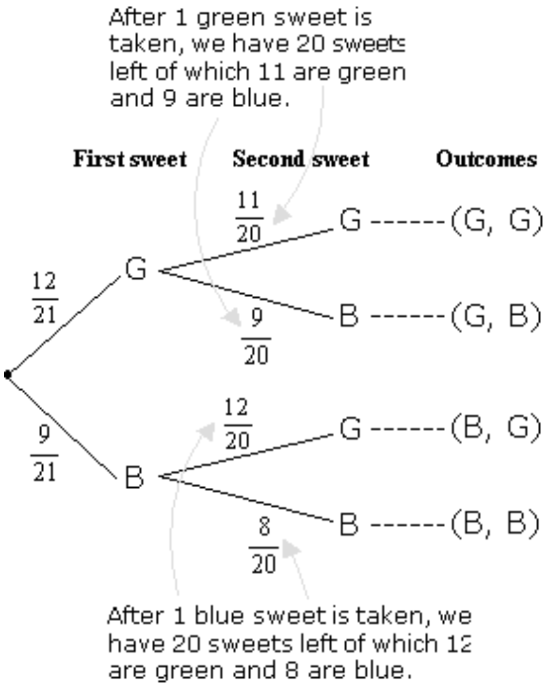
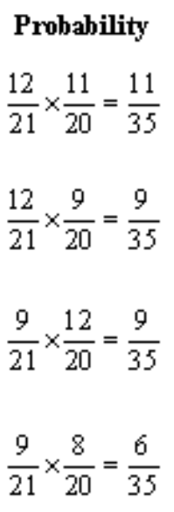
24
7
30
Topic: Probability
Date: 13/06/2018
EQ – What is probability without replacement?
A jar consists of 21 sweets. 12 are green and 9 are blue. William picked two sweets at random.
Example
a) Draw a tree diagram to represent the experiment.

Slide 9
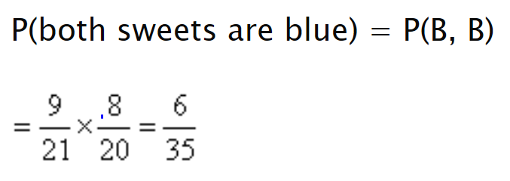
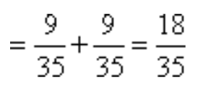
24
7
30
Topic: Probability
Date: 13/06/2018
EQ – What is probability without replacement?
A jar consists of 21 sweets. 12 are green and 9 are blue. William picked two sweets at random.
Example
a) Draw a tree diagram to represent the experiment.
b) Find the probability that i) both sweets are blue.
ii) one sweet is blue and one sweet is green.
= P(G,B) + P(B,G)

Slide 10
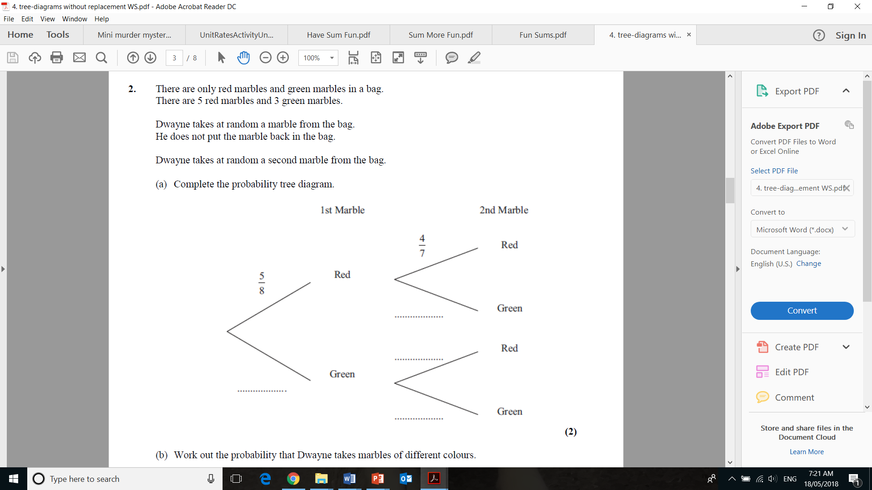
Task

Slide 11
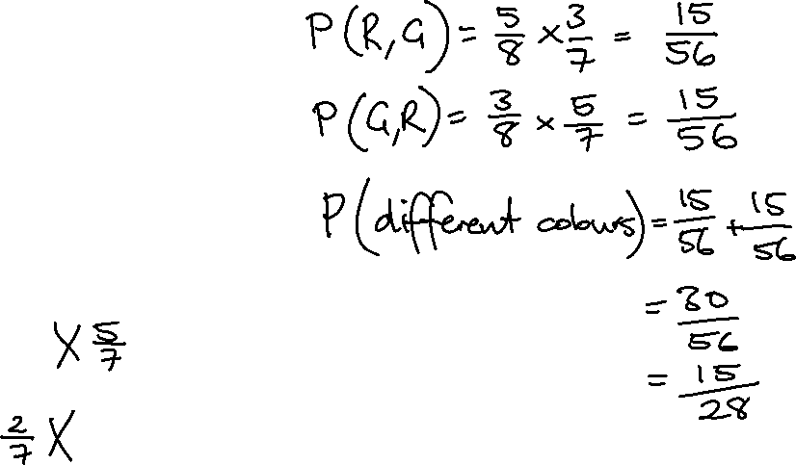
Task

Slide 12
Task
Dwyer Year 10 Text, Exercise 8.4, Questions 1-4, p.107

